Slide 1

Algorithms and Data Structures 1 CS 0445
Fall 2023
Quick Sort and Radix Sort
Sherif Khattab
ksm73@pitt.edu
(Slides are adapted from Dr. Ramirez’s and Dr. Farnan’s CS 0445 slides.)

Slide 2
Announcements
Upcoming Deadlines:
Homework 9: Tuesday 11/14 @ 11:59 pm
Programming Assignment 4: Friday 11/17 @ 11:59 pm

Slide 3


Sorting Algorithms
Efficiency of sorting is significant
O(n²)
O(n log n) – optimal for comparison sort
Quick Sort* (O(n log n) on average)
O(n)
Radix Sort (non-comparison sort)
 | In-place | Stable | Adaptive | Other
Bubble Sort
Selection Sort |  |  |  | progressive
Insertion Sort
Shell Sort
Merge Sort

Slide 4
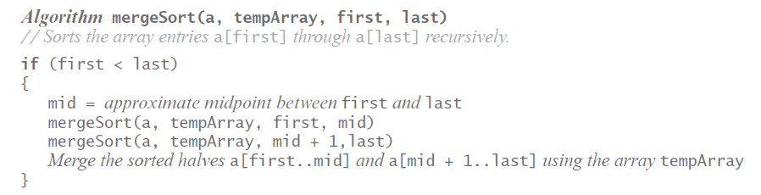
Merge Sort is NOT tail-recursive
after the second recursive call, merge method is called

Slide 5
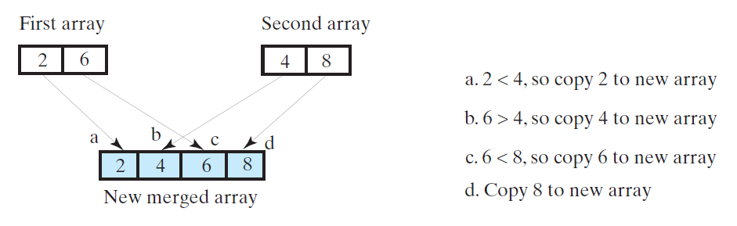
Efficiency of Merge Sort
Merge Operation is O(n)

Slide 6
Runtime Analysis of MergeSort
Proof by Induction
check video
Recursion Tree
check video

Slide 7
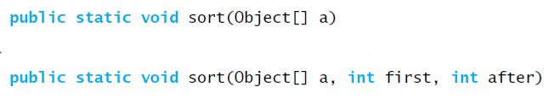
Merge Sort in the Java Class Library
Class Arrays in package java.util defines versions of a static method sort

Slide 8
Quick Sort – Basic Idea
divide input into two partitions based on pivot entry
1st partition: all entries <= pivot
2nd partition: all entries >= pivot
place pivot between the two partitions
Pivot placed in sorted position (i.e., position in final sorted array)
partitions are not necessarily equal in size
Recursively sort each partition

Slide 9
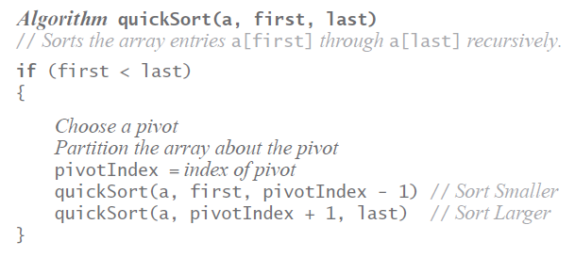
Quick Sort

Slide 10
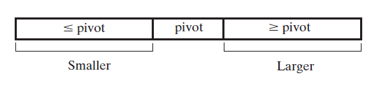
The Partition Operation

Slide 11
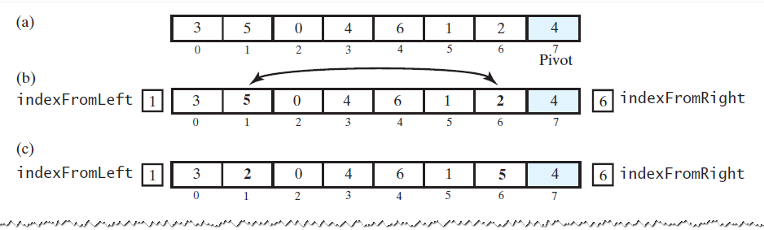
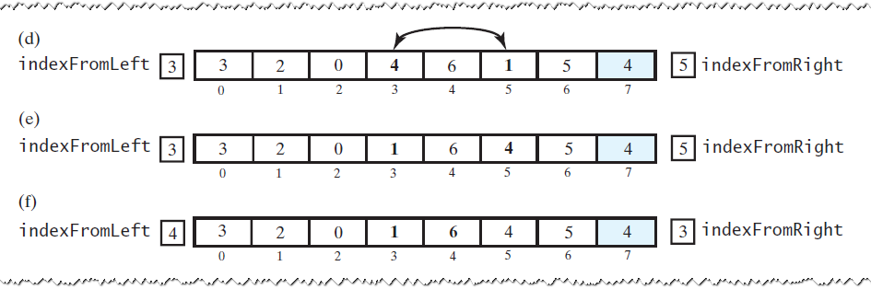
Simple Partition
Pivot is last element in partition

Slide 12
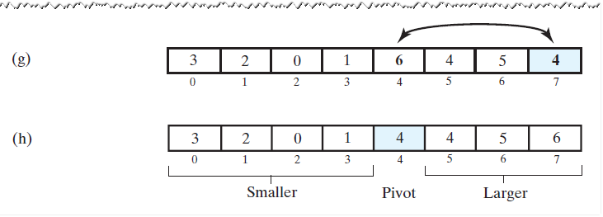
Simple Partition
Swap pivot to sorted position (between partitions)

Slide 13
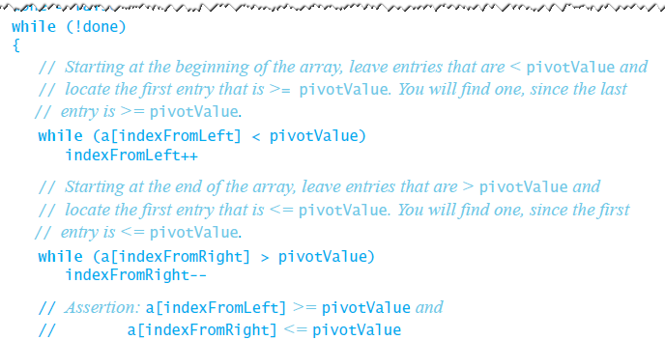
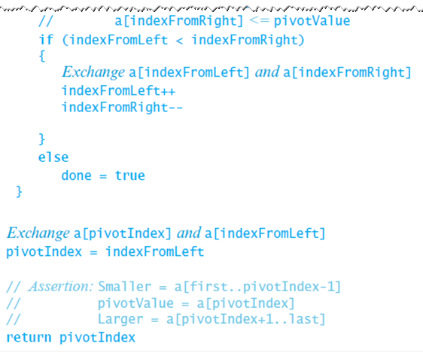
Partition Algorithm

Slide 14
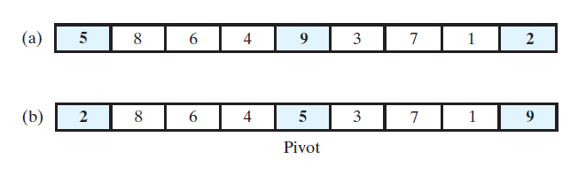
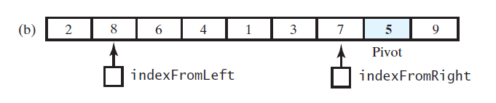
Pivot Selection: Median of Three
Sort first, middle, and last elements of input
Middle element is pivot
Move pivot to next-to-last position

Slide 15
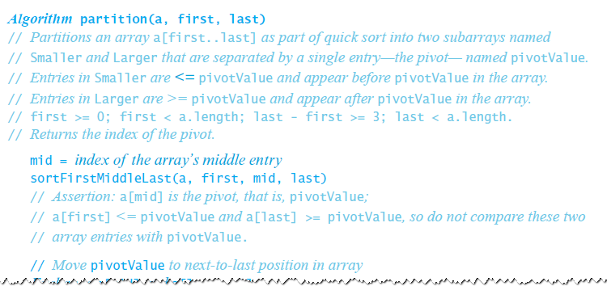
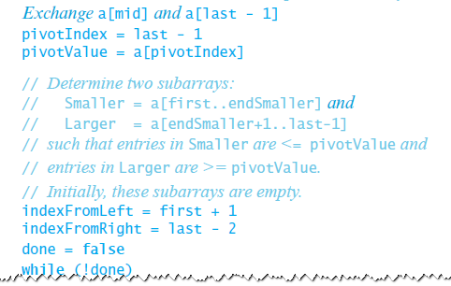
Adjusting the Partition Algorithm

Slide 16
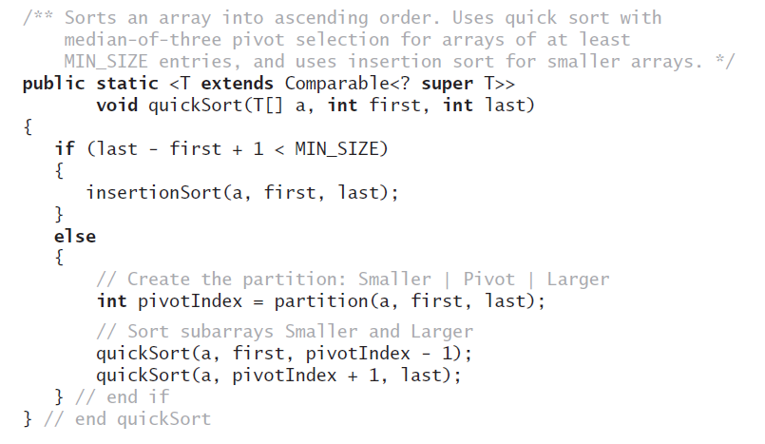
Input size must be > 3
Optimizing base case by calling Insertion Sort

Slide 17
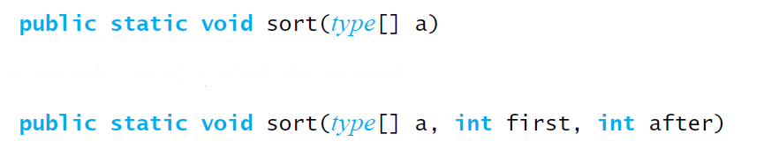
QuickSort in the Java Class Library
Class Arrays in the package java.util uses a quick sort to sort arrays of primitive types into ascending order

